Slide 1
SQL Server Monitoring & Troubleshooting with SSMS Dashboard

Slide 2
Prerequisite
SQL Server Database Engine Installed and Database AdventureWorksDW Restored
SQL Server Management Studio Installed

Slide 3
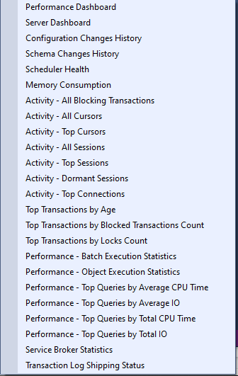
SSMS Dashboard for SQL Server

Slide 4
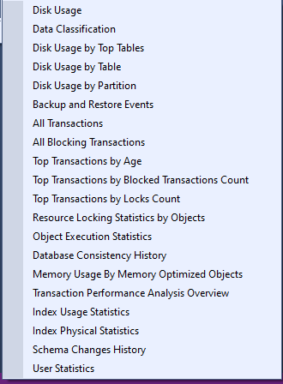
SSMS Dashboard for SQL Server Database

Slide 5
Thanks for watching!
Please leave a comment if you have any questions!
If you like this video, please hit the below LIKE button and Subscribe it..

